Slide 1
Redacting documents with local AI models
A 5-day prototype, built with Claude
Dave Berry · Answer Digital

Slide 2



The one thing to remember
AI can be the worker, not just the workflow automation
A real working app
Local models
Built in 5 days
Not a slide of ideas: you can open it and use it
Everything runs on one machine, nothing leaves it
Stories and plans in, working software out

Slide 3




Redaction is slow, and mistakes are costly
Sensitive documents need names, addresses, ID numbers and more taken out before they can be shared. Doing it by hand is slow, tedious and easy to get wrong.
Why now
Trade Remedies Authority
People
Addresses
Our new client has just entered its discovery phase. Handling sensitive case documents safely is exactly where this could help.
ID numbers
Emails and phones

Slide 4



Why local models?
Documents stay put
No per-token bill
Safe to test
Nothing is sent to a cloud API. The text never leaves the machine.
Run it over thousands of documents without watching a meter.
We can try, measure and replay runs freely, because nothing is exposed.
New to this? Ollama is a free app that downloads and runs open AI models on your own computer. Our app talks to it like it would talk to a cloud service.

Slide 5
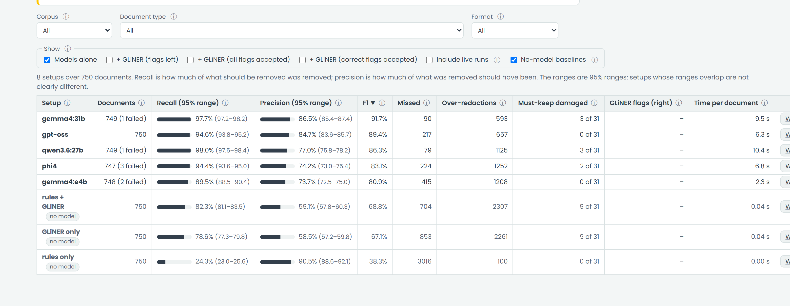
What I built: the results Explorer
4
2
3
1
1
Each row is a setup: one AI model, or no model as a baseline
2
Recall: how much of the sensitive text was removed
3
Over-redactions: removed, but it did not need to be
4
Filters slice the results by document type or format

Slide 6
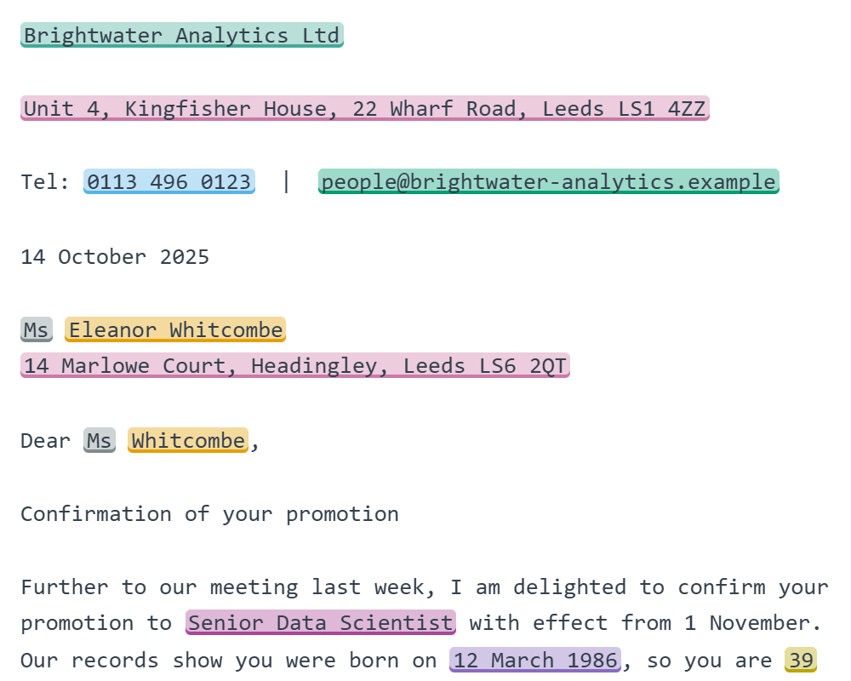
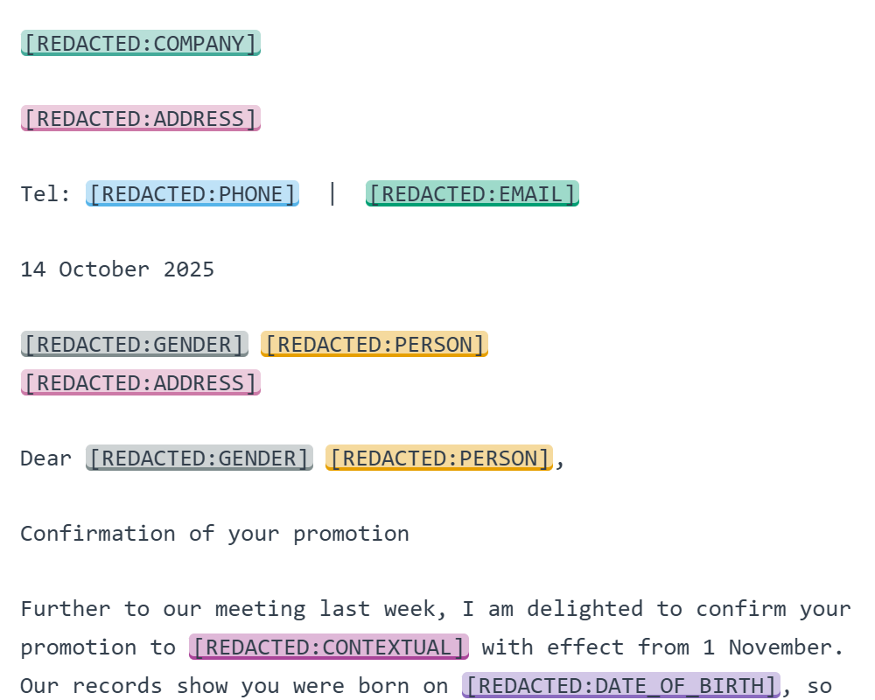
Before and after
ORIGINAL
REDACTED BY GEMMA4:31B
A synthetic HR letter. Each removal is labelled with what it was: company, address, phone, email, person, date of birth.

Slide 7
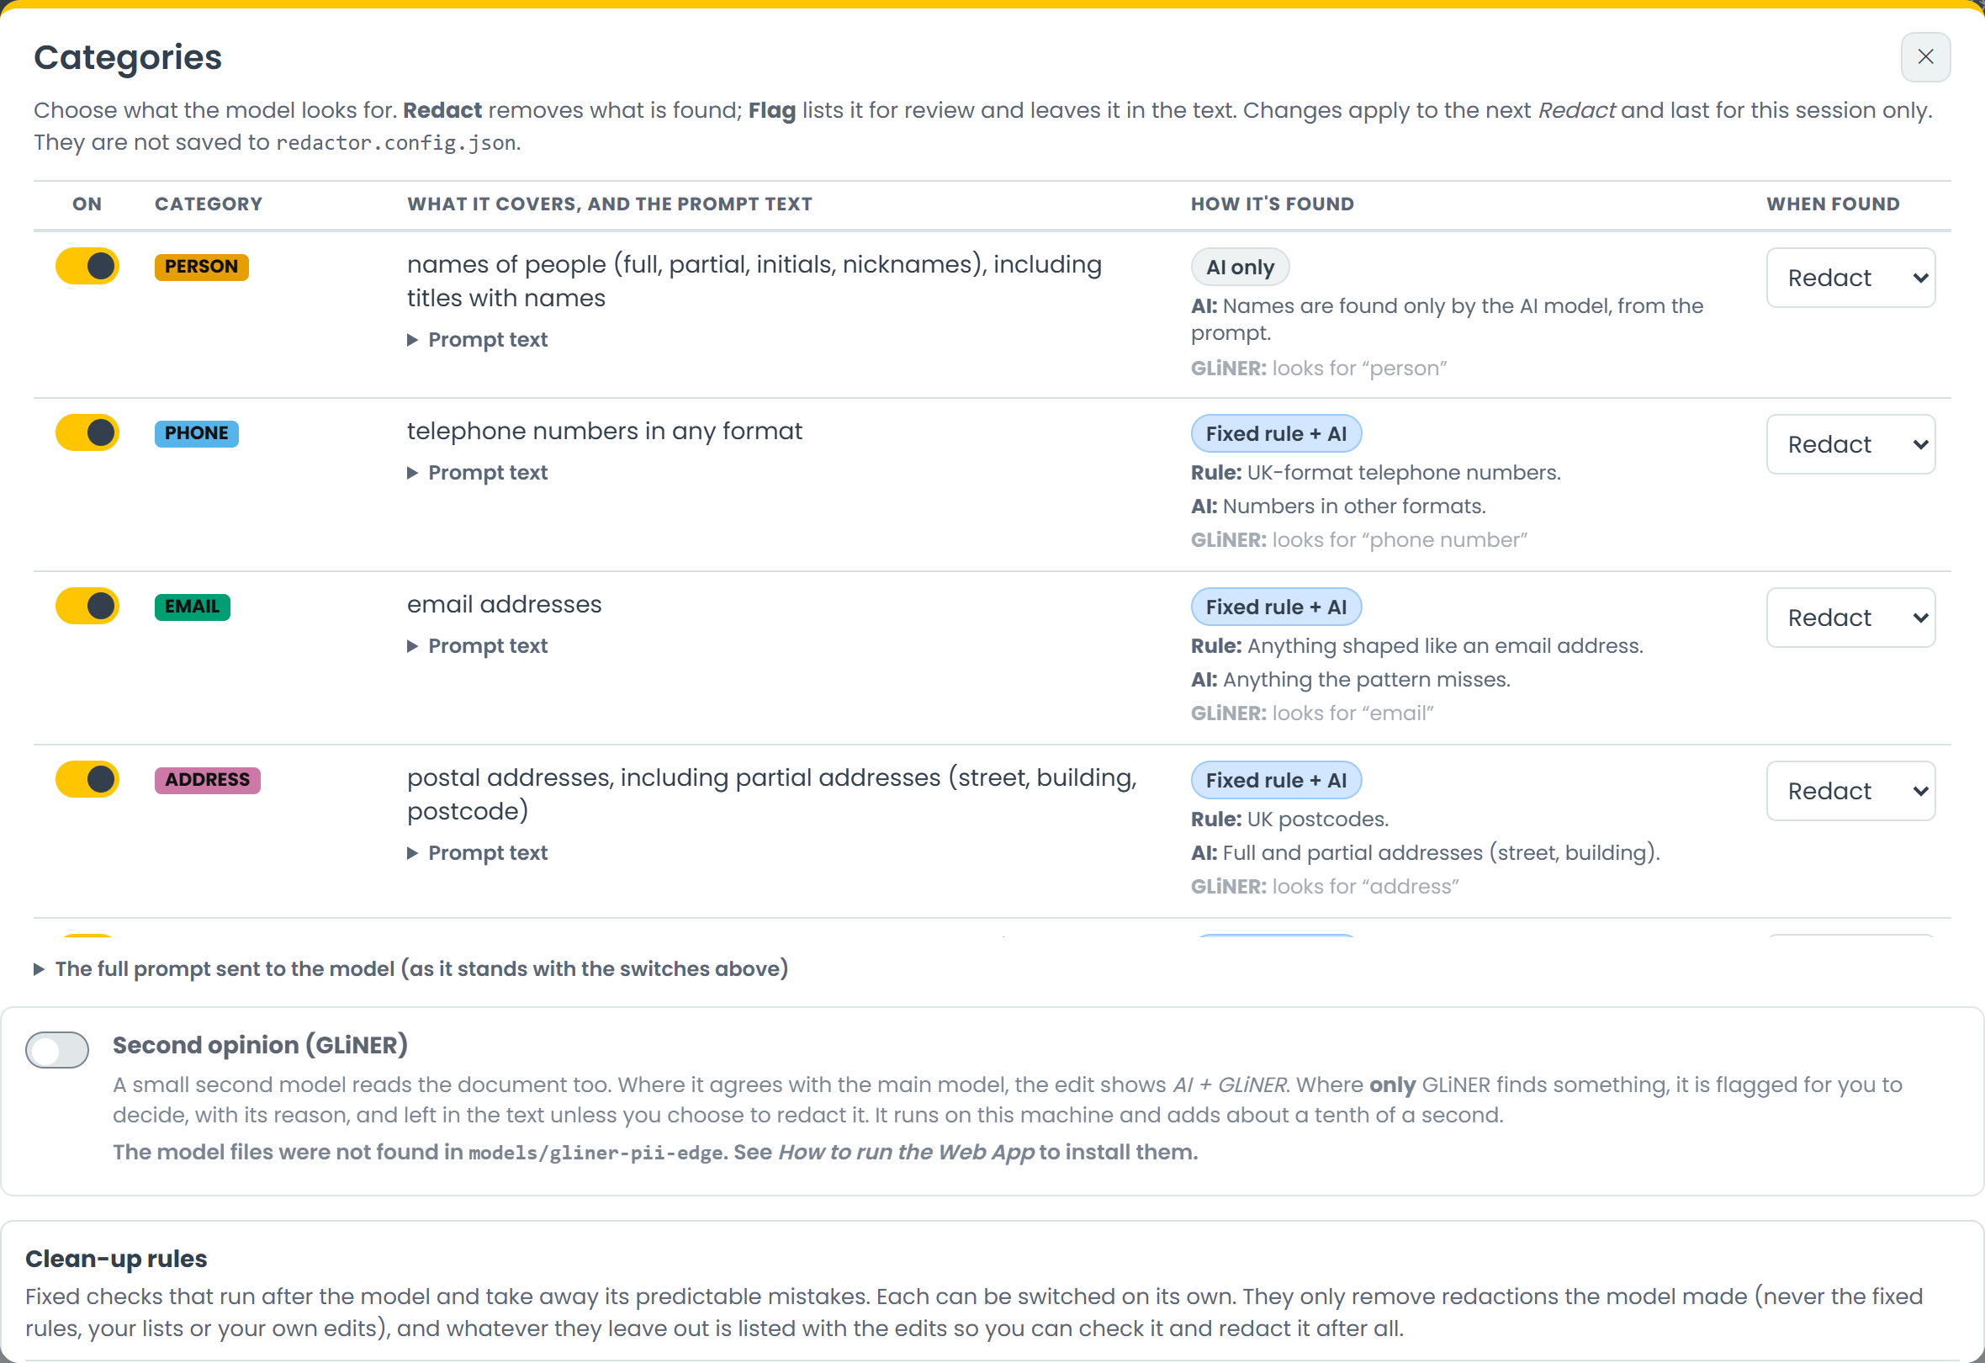




How it finds things
Fixed rules
Precise patterns for the obvious: emails, UK phone numbers, postcodes
An AI model
Reads the document with a prompt you can see and change
A second opinion
GLiNER, a small model that flags what the first one missed
Your own terms
Custom lists, such as project codenames
Screenshot: the Categories dialog. Switch each category on or off, and choose Redact or Flag.

Slide 8


Architecture: simple on purpose
Documents
Local model
Results
Word, PDF, scans, text, CSV, JSON
Called on this machine through Ollama
Redacted files, edits and scores stored as data
Document in, model called locally, results stored. Nothing else leaves the building.

Slide 9
Prototype first, then measure
1
2
3
4
Tiny prototype
Real documents
Evaluation suite
The Explorer
One category at a time, to see whether a local model could do it at all
Found realistic synthetic finance documents on Hugging Face
Grew it into a harness that runs every model over every document
A UI to compare, replay and understand every result

Slide 10
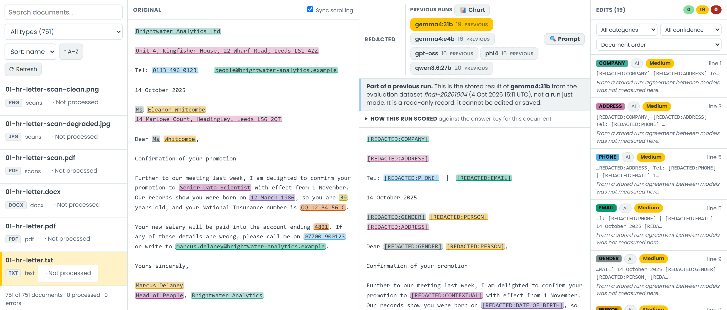
Measure everything, then replay it
2
1
3
1
Previous runs: replay a stored result
2
The original, with every sensitive item highlighted
3
The edits list: each change and its category
Exported as much data as possible: stats first, then the actual output documents and every edit. That allows accurate comparisons and replays in the UI. Claude analysed each run and helped choose the next one.

Slide 11
The evaluation in numbers
11
5
models tried at the start
models kept for the long runs
750
17,250
documents, in several file types
results to compare
About 5 long runs. Final dataset: 4 October 2026.

Slide 12
Which models can we recommend?
BEST ALL-ROUNDER
gemma4:31b
97.7% recall, 86.5% precision, 9.5 s per document
BEST BALANCE OF SPEED AND ACCURACY
gpt-oss
94.6% recall at 6.3 s, about a third faster
FASTEST, FOR A FIRST PASS
gemma4:e4b
2.3 s per document, but it misses the most
750 documents, final dataset. Higher is better for both.

Slide 13
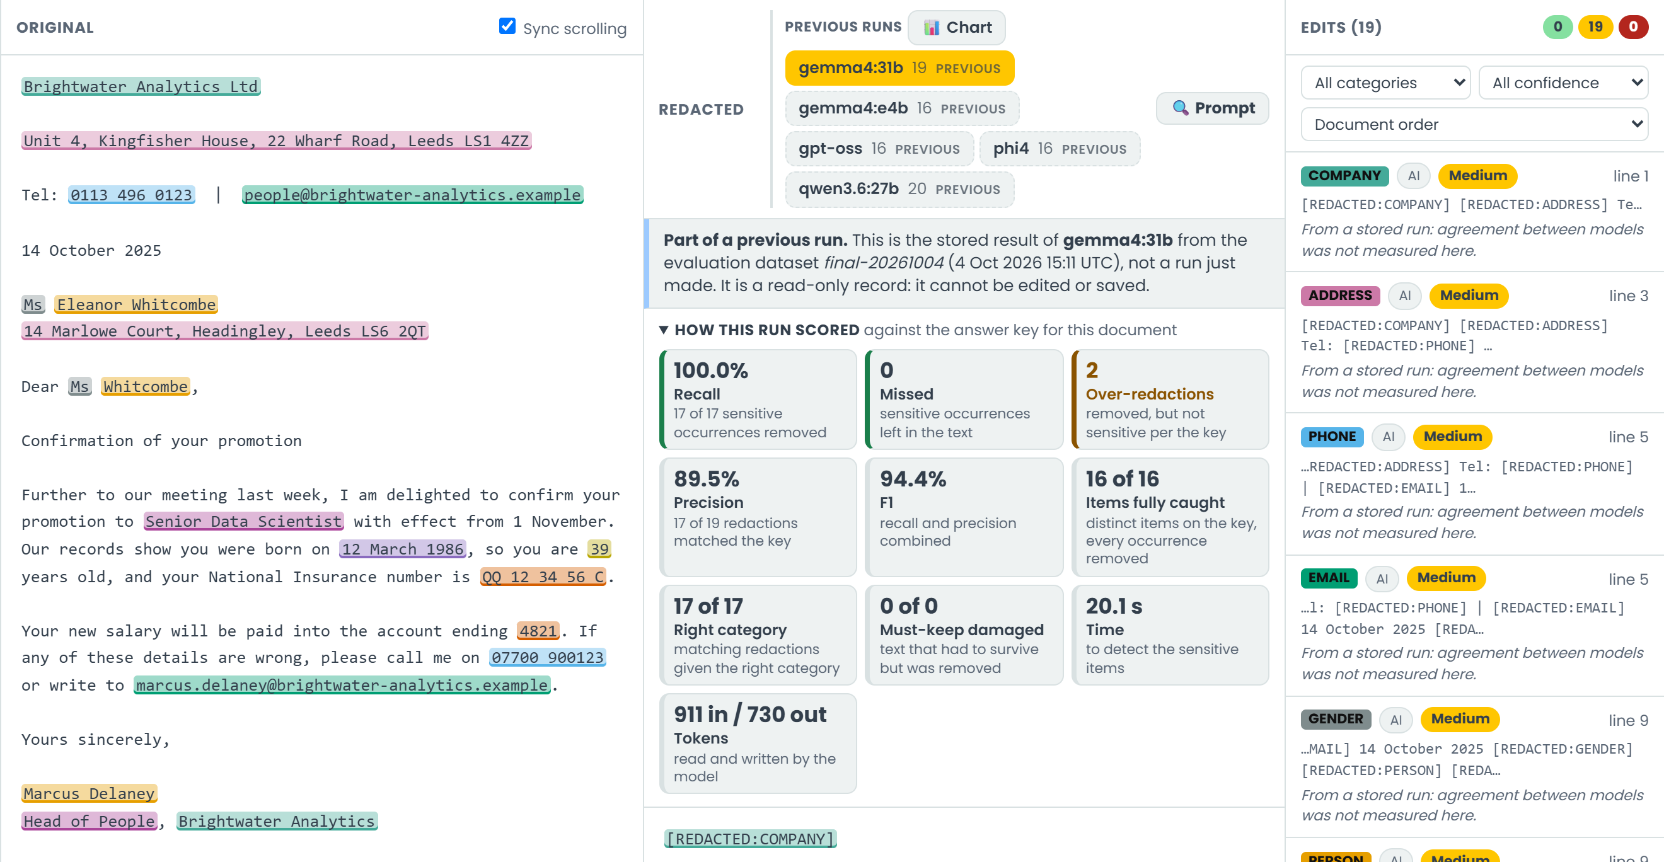
Marked automatically, safely
Local and private means we can evaluate openly. Each result is marked against an answer key, so every run gets a score.
Recall, precision, missed items, over-redactions and time, all worked out automatically
Any stored run can be replayed in the UI
Answer keys: generator labels checked by rule, or written by hand

Slide 14
How it was built
Write a story
Agree a plan
Claude builds it
I review and steer
5 days from first idea to a working app and evaluation suite
No direct coding: stories and plans in, working code out
Smaller stories worked better than big ones
Honest note: this is not a complex app. The point is how fast the loop is

Slide 15



Try it, or ask me
Download the project
github.com/DavidBerryUK/AiRedaction (public)
See the evaluation data
Open the Explorer and browse all 17,250 results
Ask me about it
Scan for the repo
dave.berry@answerdigital.com

